Slide 1
Data Analysis of Hyatt Hotel Dataset
Team 2
Radhika Bhange
Farheen Safoora Najeeb
Harsh Takrani
Ashik Liyakathali

Slide 2
Introduction
The main aim of this project is to carry out data analysis on the Hyatt hotel data set to gain insights for improving the Net Promoter Score of the Hyatt Chain of Hotels.
The data is provided for 12 months and 53 countries in total.
Attributes: 237 columns, having details about the person who responded to the survey, few attributes about the hotel and a column that indicates whether the person is a promoter, passive or detractor.

Slide 3
Steps followed to analyze the dataset:
Data cleaning
NPS Calculation
Region Selection for the data analysis
Visualization of the Data based on the analysis
Business cases
Use modelling techniques
Give recommendations based on the analysis

Slide 4
Net Promoter Score
The Net Promoter Score (NPS) is an index ranging from -100 to 100 that measures the willingness of customers to recommend the hotel to others.
Customers are surveyed on one single question. They are asked to rate on an 11-point scale the likelihood of recommending the company or brand to a friend or colleague.
Based on their rating, customers are then classified in 3 categories: detractors, passives and promoters.

Slide 5
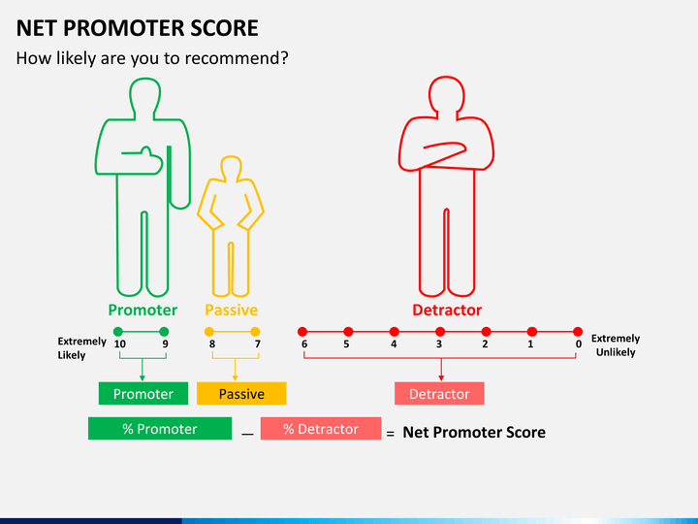
NPS Calculation
For NPS calculation, we used the formula:
Actual NPS = ((No. of Promoters – No. of Detractors) / (No. of respondents)) * 100

Slide 6
Steps taken to obtain the Final Dataset
Analyzed the initial data consisting of 237 columns
Separated data based on the countries
Calculated the total number of detractors and NPS score per country in order to devise business solutions according to the country.
Calculated a fraction of the number of detractors upon the total number of people in the given dataset per country to determine the country.
Removed NA’s from NPS Type and the Likelihood_Recommend_H column

Slide 7
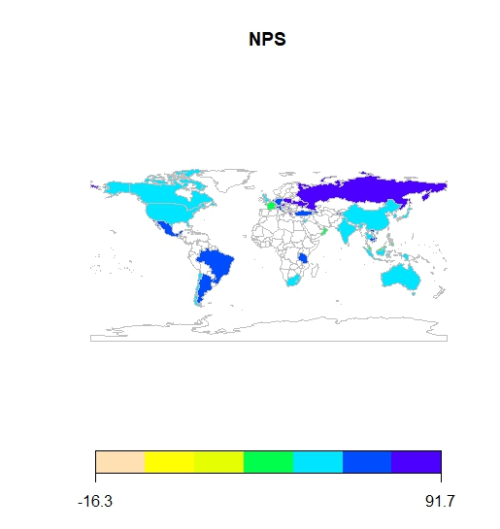
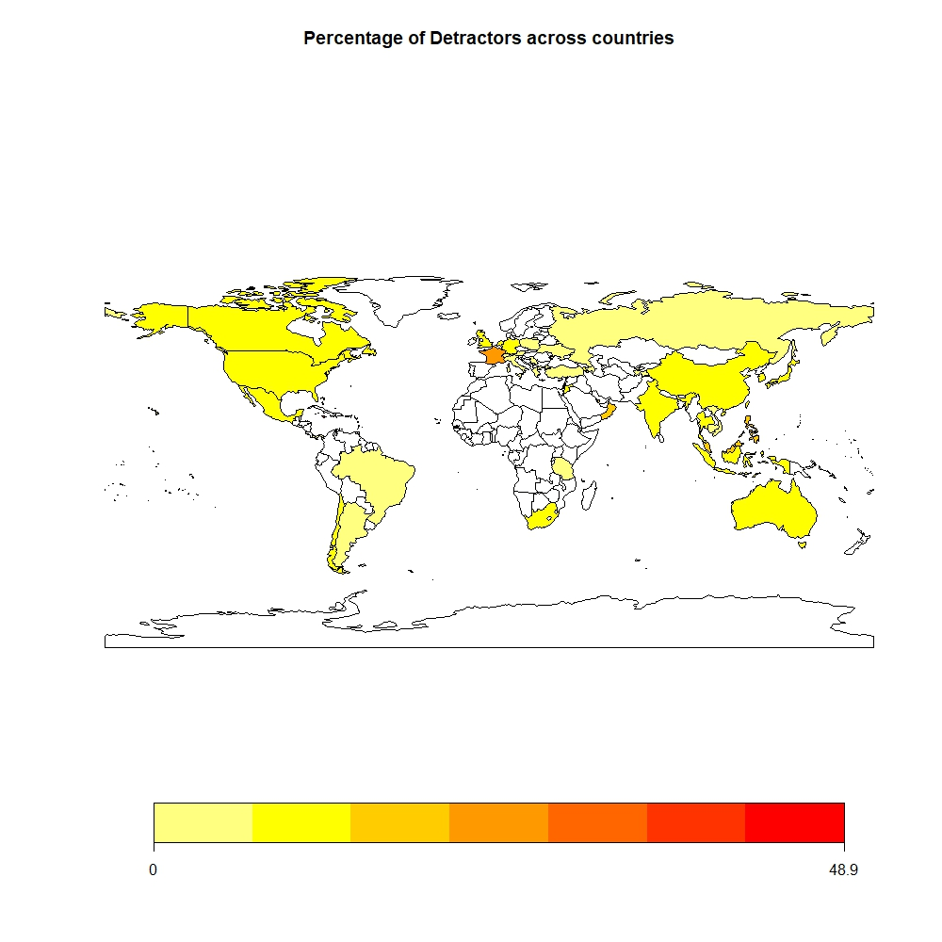
Visualization: NPS and percentage of detractors across each country

Slide 8
Steps taken to obtain the Final Dataset
The countries that stood out with high detractor percentage and low NPS scores were France, Jamaica and Guam.
Considered only the France data as Jamaica and Guam had a large number of outliers.
Since USA has the largest number of Hyatt Hotels in the world, it was taken into consideration as one of our viable countries because of the large target audience available.
The Final Dataset has 35 columns to be used for further analysis.
After obtaining 35 columns, the columns having more than 60% of NA values were removed and then categorized the likelihood to recommend column to low(0-6), high(9,10) and medium(7,8).

Slide 9
Data modeling techniques
The following data model techniques were used for our analysis -
Linear Model
SVM model
Association Rules
Random Forest Algorithm
These models were useful in determining the results for our business questions to come up with recommendations for Hyatt to develop their business strategies.

Slide 10
Business Questions
Determine the relationship and effect of purpose of visit ie. Business and leisure on the likelihood to recommend (France)
We found that 81% of the customers came for business visit.
For the business customers :
We found that the citizens of France have a high likelihood to recommend(Support =0.15, confidence=0.56, lift=0.9)
US guests also have quite high likelihood to recommend(Support =0.16, confidence= 0.62, lift = 1.12)
As the number of people who visit hotels for leisure, in France are comparatively less in number, no significant impact of the leisure customers is found on the likelihood to recommend.

Slide 11
Business Questions
What is the effect of the type of room on likelihood to recommend?
We have used association rules mining to find the effect of the room type on the likelihood to recommend.
We found that for the France data, there was no significant impact of the room type.
For the US data, we found that king size room and DDBL rooms have a positive effect on the likelihood to recommend.(support=0.01, confidence=0.6)
Hence they should maintain these rooms and try to improve the conditions of the other room types.

Slide 12
Business Questions
What factors influence likelihood to recommend?(France)
We considered the 10 metric columns from the data for linear modelling.
Initially we checked likelihood to recommend with each individual column but that did not give any satisfactory result.
The best model that we got gave us a Multiple R-squared value of 0.7136 and the Adjusted R-squared value of 0.7132.
We found that the factors that affect likelihood to recommend the most are:
Guest room satisfaction, Hotel condition, Quality of Customer service, Staff cared and Overall food and beverages experience.

Slide 13
Business Questions
What factors influence likelihood to recommend?(USA)
Initially we checked likelihood to recommend with each individual column but that did not give any satisfactory result.
The best model that we got gave us a Multiple R-squared value of 0.69
We found that the factors that affect likelihood to recommend the most are:
Guest room satisfaction, Hotel condition and Customer service satisfaction

Slide 14
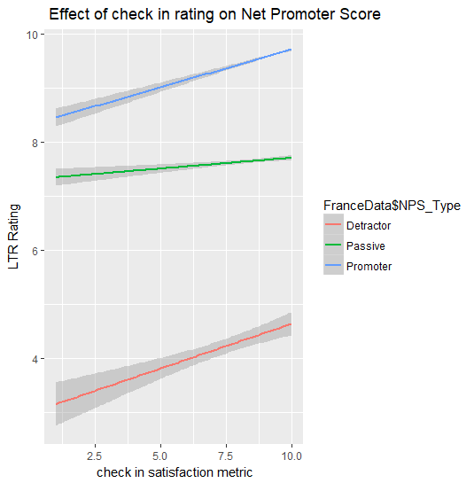
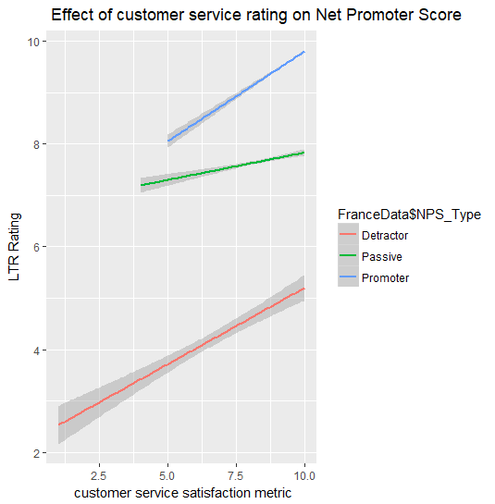
Visualization

Slide 15
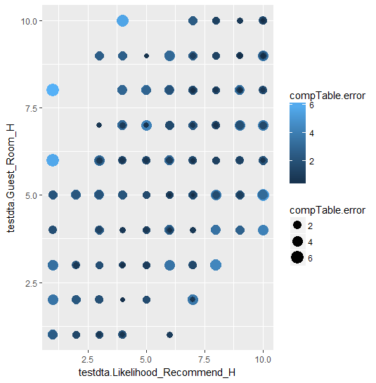
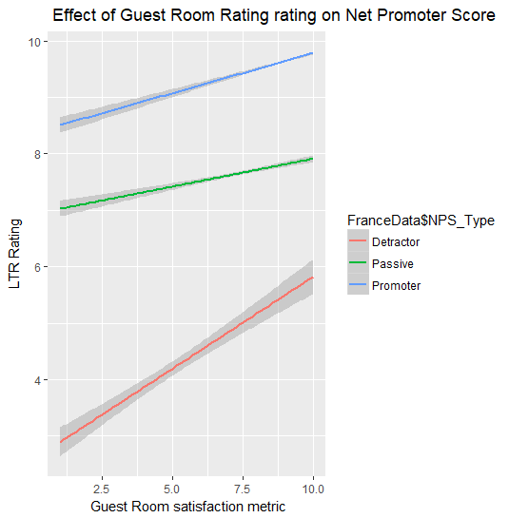
Visualization
Using Linear model
Using SVM

Slide 16
Business Questions
What is the effect of different facilities that the hotel provides on the likelihood to recommend?
For the France dataset, there is no effect of these different facilities that the hotels are providing to their customers. Keeping in mind, the majority of customers come for business purposes.
For the US dataset, Business customers:
Leisure facilities like spa, golf, casinos are not present, hence there is no effect on the likelihood to recommend.
Even the conference rooms are not present and still the likelihood to recommend is high.
The business centers are important as they have an effect on likelihood to recommend.
For leisure customers: The hotels not having utilities like spa, golf course, mini- bar, casinos also have a high likelihood to recommend .
We observed that both the countries have a minority of leisure travelers and that might be due to the reason that a lot of Hyatt hotels do not have these leisure facilities.

Slide 17
Conclusion
With the analysis carried out on the data, we can conclude that below are the factors which affects and influences the NPS:
Customer Service
Staff Care
Condition of the hotel
Guest Room
Food and beverages

Slide 18
Our Recommendations
The hotel chain should invest more on the hotel condition, customer service, staff cared, guest room and overall Food & Beverages, for France.
The hotel chain should invest more on the hotel condition, customer service satisfaction and guest room satisfaction, for USA.
As majority of their customers are for business, they can concentrate on business customers and devise strategy to attract them through promotions.
As the leisure customers are in minority, the hotel chain should try to attract them by including leisure facilities in their hotels .
For the business customers, business centers should be included in their hotels and kept in good conditions as they have a high impact for recommendation.
As the king size room and double bed room have a greater impact on likelihood, they should maintain these rooms and try to improve the conditions of the other rooms.

Slide 19
Thank You!

